Slide 1
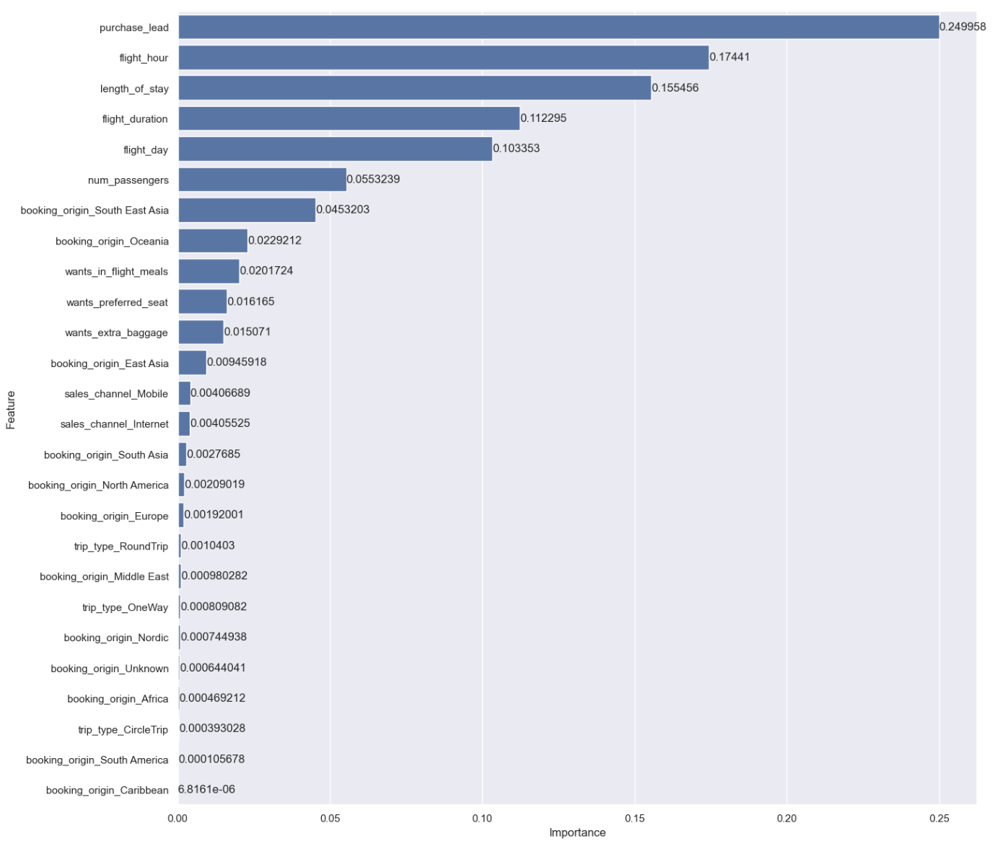
Random Forest Prediction Model
Random Forest Model: Predict outcome of airline booking.
Data includes:
Number of passengers
Trip type
Length of stay
Flight duration
Random Forest Performance:
Accuracy: 85.07%
Precision: 48.3%
Recall: 10.75 %
Most important variables:
Purchase lead
Flight hour
Length of stay
Flight duration
Flight day
Notes:
A Random Forest Model was created to predict the outcome of whether a potential passenger would book a flight with British Airline or not.
The data used consists of 50000 airline bookings and whether the booking was completed.
The data includes information such as the number of passengers being booked, the type of trip, length of stay, flight duration, whether the passenger wants extra baggage or preferred seats, or inflight meals.
The Random Forest Model was able to predict whether passengers completed their booking with an 85.07% overall accuracy.
The Model’s precision describes of all the time it predicted that a passenger would book a flight, only 48.3% of those predictions were true.
The Model’s recall describes of all the times a passenger books a flight, only 10.75% of the bookings were predicted by the model.
The model’s low precision and recall shows that the model requires improvement.
Adding more customer centric features, such as whether the customer will recommend the flight, would improve the model.
In this model, the 5 variables with the most influence on whether a passenger would book a flight are the purchase lead, flight hour, length of stay, flight duration, and flight day.

